Slide 1

Why Technology is Detrimental to Schools
“Technology! I feel as if we’re being swept down this enormous river-we don’t know where we’re going, or why, but we’re caught in the current. I think we should stop and take a look before it’s too late.”
Assistant Superintendent of Schools, Long Island, New York
Notes:
Unfortunately this quote represents the thinking of many schools today. In the past few years there has been a huge push in elementary schools to get computers and media technology into the classrooms without much thought or substantiated evidence that this technology is actually improving our children’s knowledge. According to Jane Healy, an educational psychologist “most of the research that has been done regarding the effects technology has on actual learning, has been done by people with an axe to grind, particularly people who would like to see that computers and media really help, such as the technology firms that produce the very technology they are studying.” Not exactly unbiased research.

Slide 2

Introduction
Negative effects, high costs, ineffective strategies
  Schools
  Teachers
  Students

Slide 3

The High Cost: Budget Issues
High Initial Cost
High Cost of Software, Maintenance, Training
Technology at the Cost of Other Programs
Notes:
The following slides will breakdown this information in more detail.

Slide 4
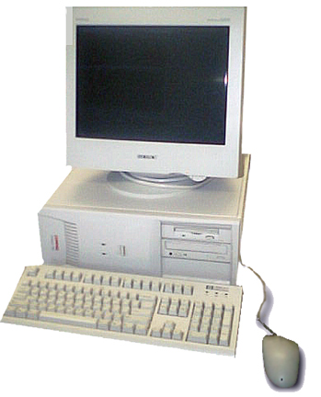
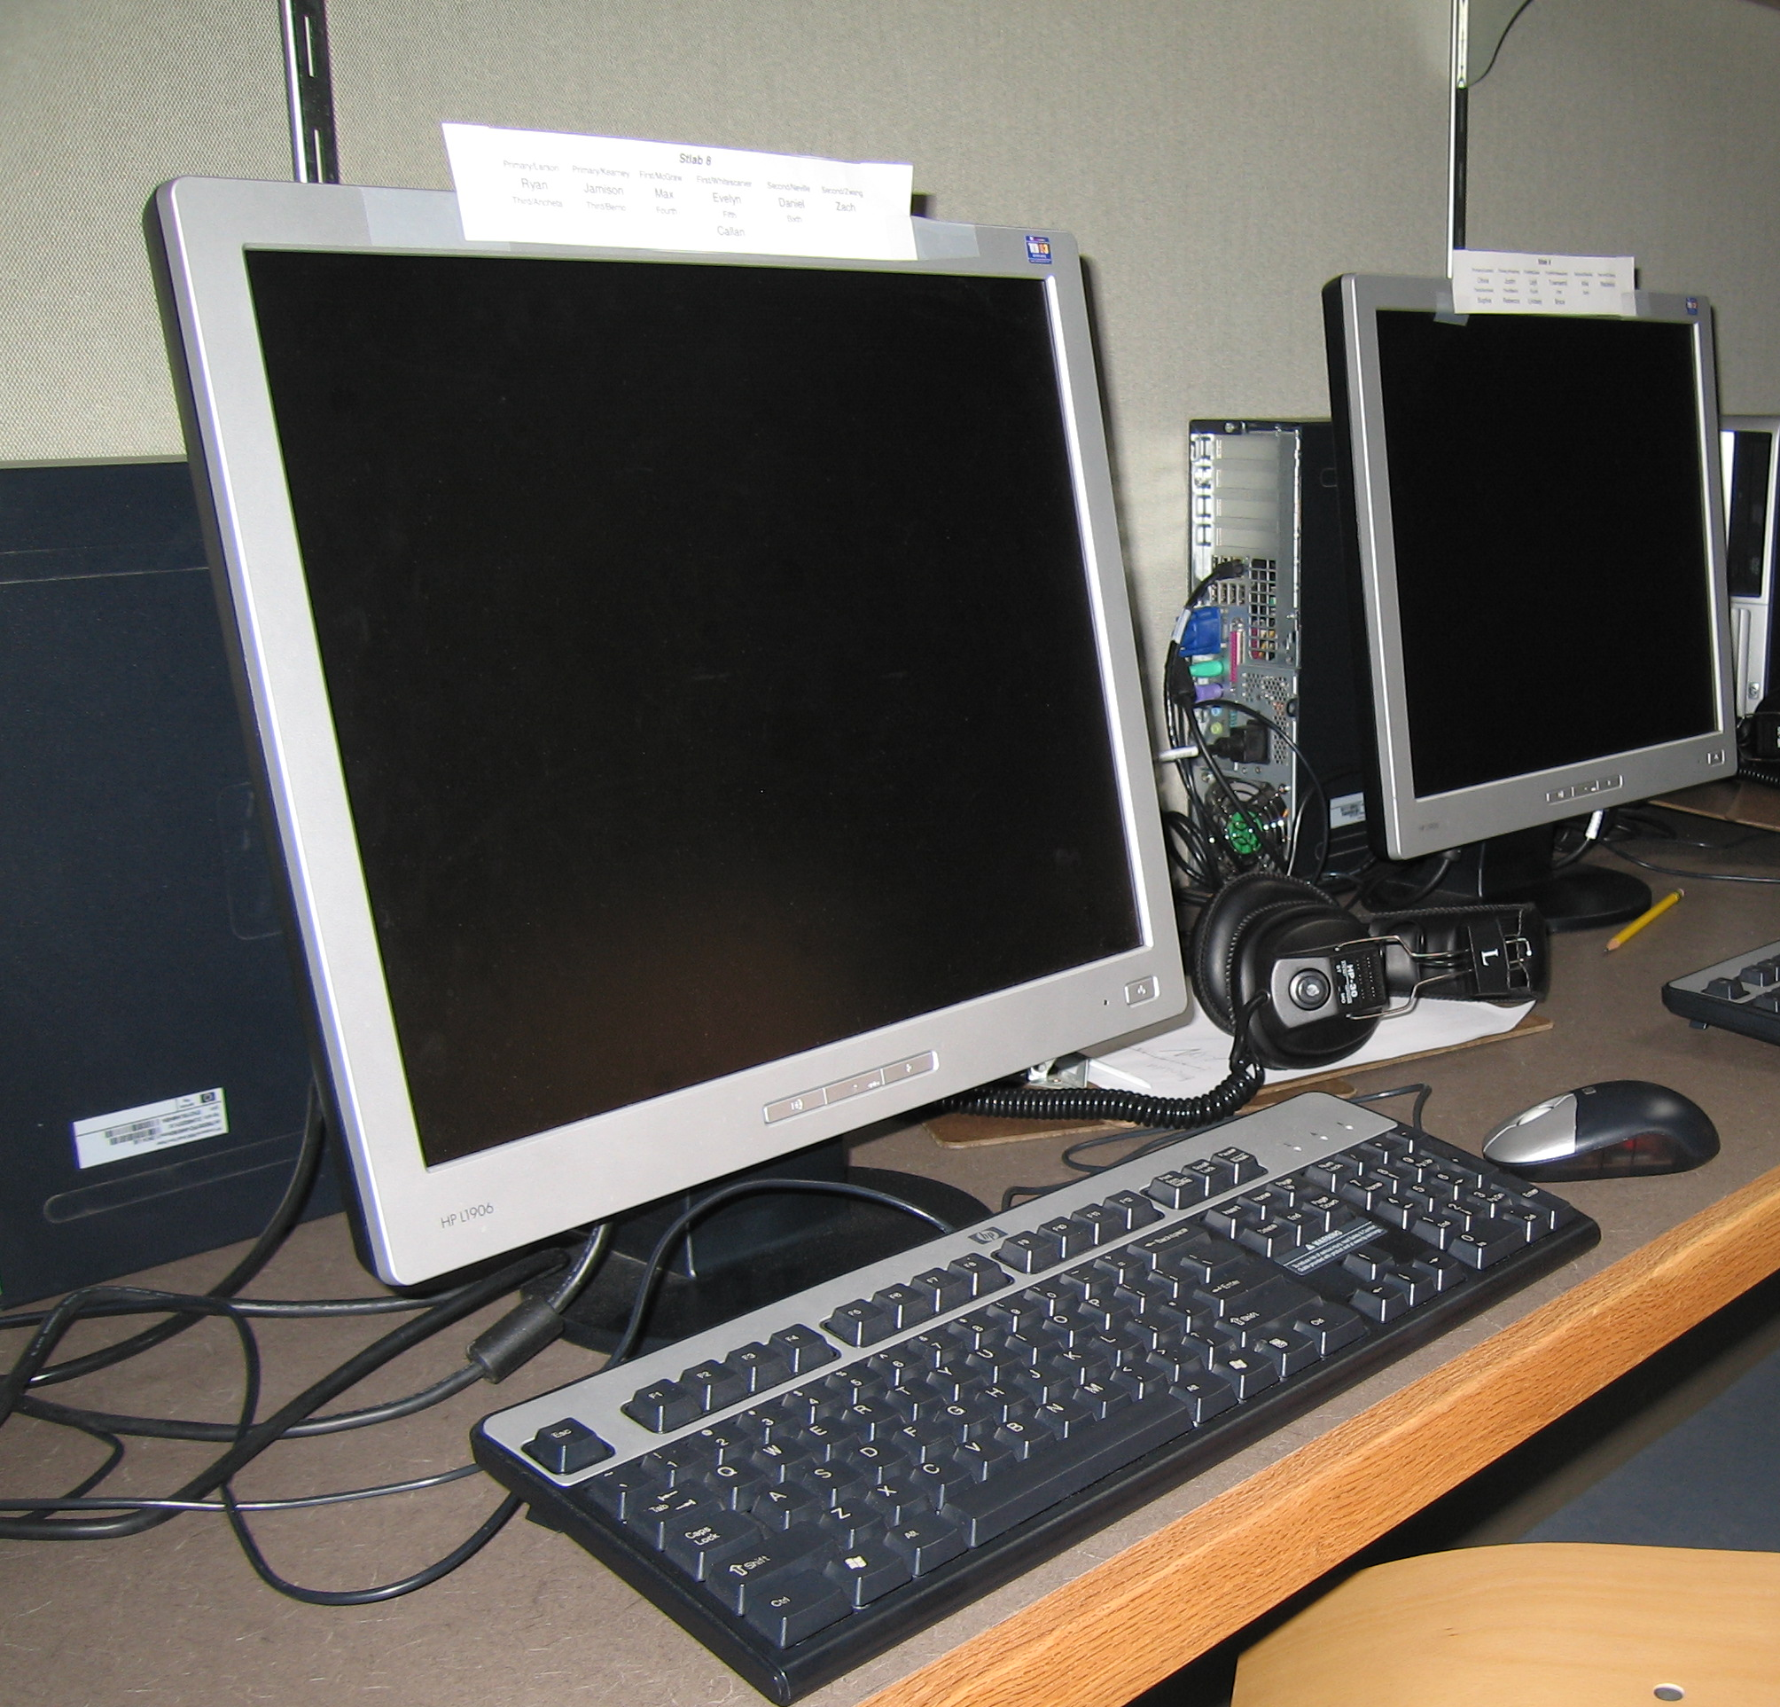
The Problem of Technology Equity in Schools
Lack of equity in funding prevents lower income schools from competing with higher-income schools in terms of technology usage.
Some schools are able to secure outside funding, and private donations to fund technological advancements in their school due simply to where they are located.
Schools have no way to regulate the phenomenon that occurs regarding equity of access at home.
VS.
Notes:
We will discuss each of these in more detail in the following slides.

Slide 5
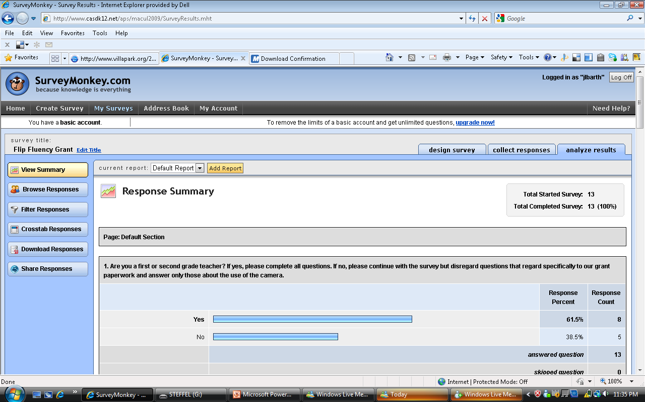
Teachers and Technology
Teacher time involvement
  how it works
  how to use it to teach
Always changing
Equity in resources, skill
Purchase own equipment
Lack of support from technology staff
  Can’t use own equipment
  “That’s not my job.”
  “We’re not teachers.”
Need things that make life easier, NOT more difficult!
Notes:
Jess – describe teaching the teachers – VERY differentiated
Time involvement – 1 hr / mo. + pd days; always enough to get started, never enough to dig deep
Even in the building – not equal resources – some have 2 - 5 computers, now 10 have smartboards but others don’t
Can’t afford what we chose – laptops for teachers in addition to smartboards
Laptops would make life easier

Slide 6
The Unproven Effects of Technology on
Kid’s Learning
Negative Effects on Kid’s Physical Health
Negative Cognitive Effects of Technology on the Growing Brain
Negative Socio-Emotional Effects of Technology on the Growing Brain
Visual Media as a Hindrance to Learning
Notes:
Here are some of the ways we are seeing kids being negatively effected by Technology.

Slide 7

Conclusion
What’s fair and equitable?
Is it worth the opportunity cost?
Is it affecting learning positively?

Slide 8
Source Material
ABC News – Nightline. Oppenhiemer, Todd; Fouts, Jeffrey; Cuban, Larry; Ziot, Matthew; Healy, Jane; Roberts, Linda. 2004
Calvert, Sandra; Rideout, Victoria; Woolard, Jennifer; Barr, Rachel. Age, Ethnicity, and Socioeconomic Patters in Early Computer Use. The American Behavioral Scientist; Jan 2005; 48, 5.
Chen, Milton; Healy, Jane; Resnick, Mitchel; Lipper, Laurie. Five Commentaries: Looking to the Future. The Future of Children; Fall 2000; 10,2.
Healy, Jane. Failure to Connect: How Computer’s Affect Our Children’s Minds – for Better and Worse, Simon & Schuster, 1998.
Healy, Jane. 10 Reasons “Sesame Street” is Bad News for Reading. The Education Digest; Feb 1991; 56; 6.
Healy, Jane. Why Slow Down the Rush toward School Computers? The Education Digest: Nov 1999; 65; 3.
Shields, Margie; Behrman, Richard. Children and Computer Technology: Analysis and Recommendations. The Future of Children; Fall 2000; 10,2.
Salomon, Graviel. Of Mind and Media. Phi Delta Kappan, Jan 1997, P.176 FTC.

